Slide 1
dbms
Module 2 part 1

Slide 2
index
Relational Model
Relational Model Constraints
ER Model to Relational Model
Relational Algebra
Select
Project
Cartesian product

Slide 3
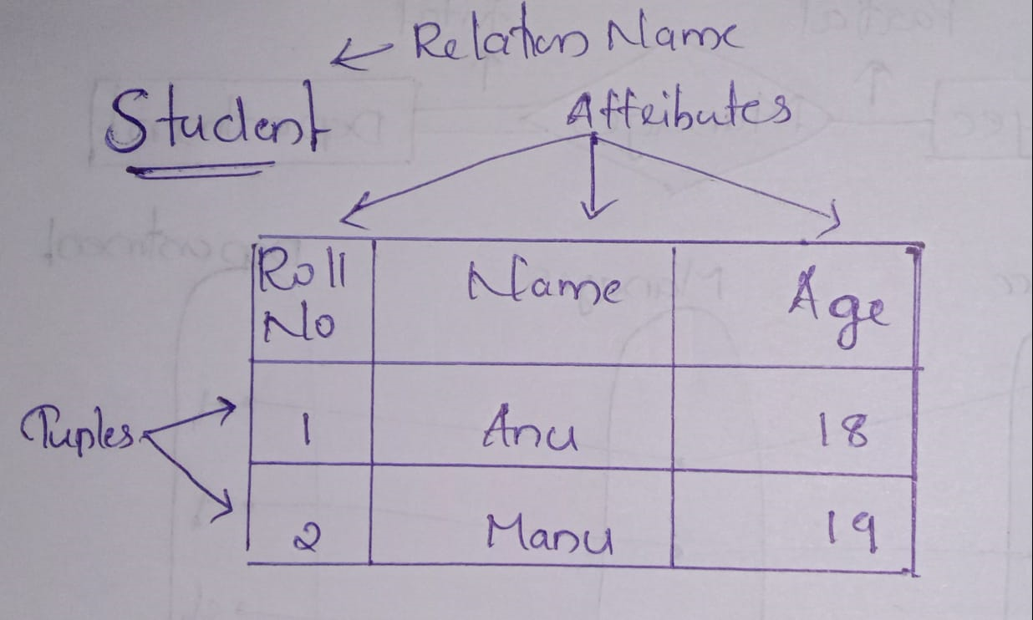
Relational model
The relational model represents the database as a collection of relations
In the formal relational model terminology,
A row is called a tuple
A column is called an attribute
The table is called a relation

Slide 4
DOMAIN
A set of atomic values allowed for an attribute
Eg:Student age
RELATION SCHEMA
Describes a relation
Made up of a relation name R and a list of attributes A1,A2,……..An
Eg:STUDENT(Name,Rollnum,Age)
STUDENT(Name:string,Rollnum:integer,Age:integer)

Slide 5
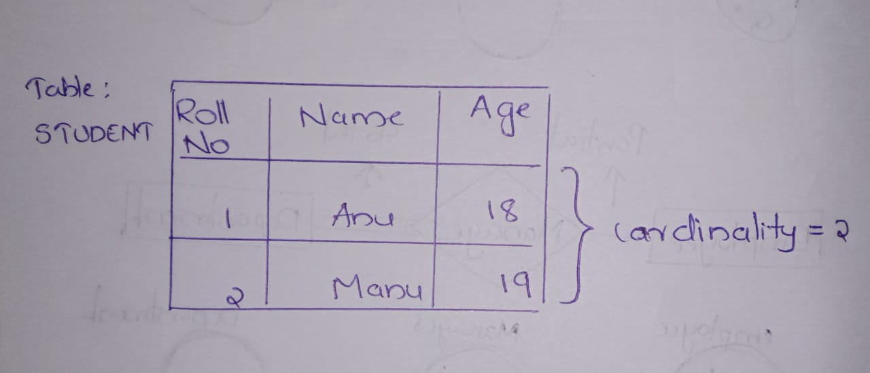
DEGREE OF A RELATION
Number of attributes in a relation schema
Eg: STUDENT(Name,Rollnum,Age)-degree-3
CARDINALITY
Total number of tuples present in a relation

Slide 6
Relational models constraints
Constraints are the restrictions or the limitations on data in the database
Inherent model-based constraints or implicit constraints: Constraints that are inherent in the data model
Schema-based constraints or explicit constraints: Constraints that are defined directly in the schemas of the data model
Application-based or semantic constraints or business rules: Constraints that cannot be directly expressed in the schemas of the data model, and hence must be expressed and enforced by the application programs.

Slide 7
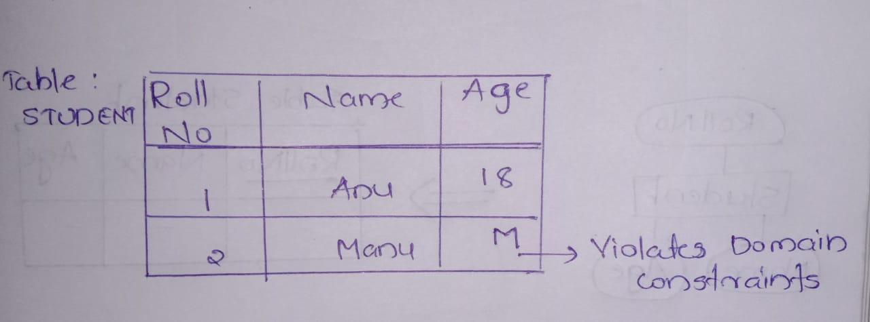
Schema based constraints
1.DOMAIN CONSTRAINTS
Must be atomic value
Performs data type check

Slide 8
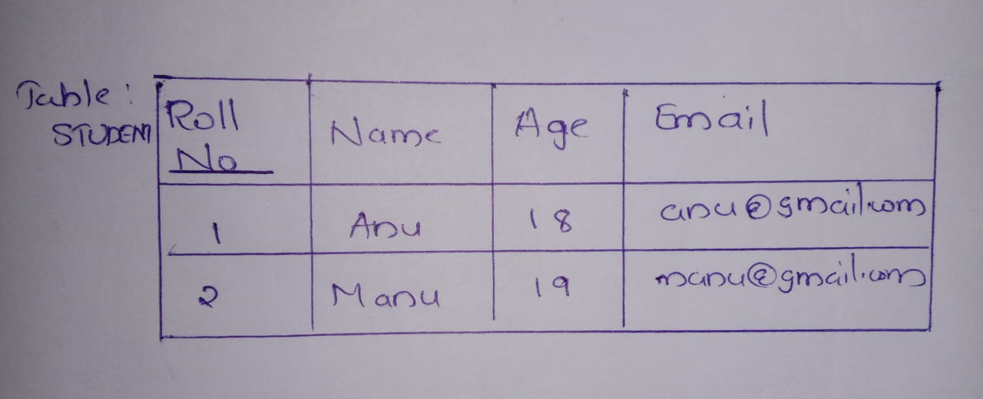
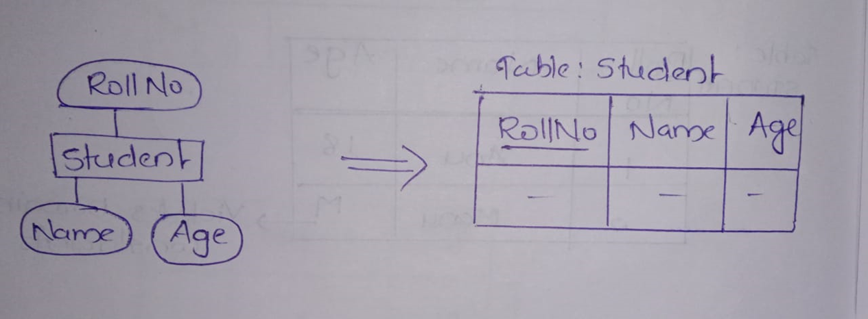
2.KEY CONSTRAINTS
An attribute that can uniquely identify each tuple in a relation is called a key
A superkey specifies that no two tuples can have the same value
Every relation has atleast one superkey -set of all attributes.EG:{RollNo,Email,{RollNo,Name},…..}

Slide 9
Candidate key is a set of attributes that uniquely identify the tuples in a relation
Eg:RollNo and Email

Slide 10
3.CONSTRAINTS OF NULL VALUES
Specifies whether null values are permitted or not(NOT NULL)
Eg:Name
4.ENTITY INTEGRITY CONSTRAINTS
Specify that no primary key value can be null

Slide 11
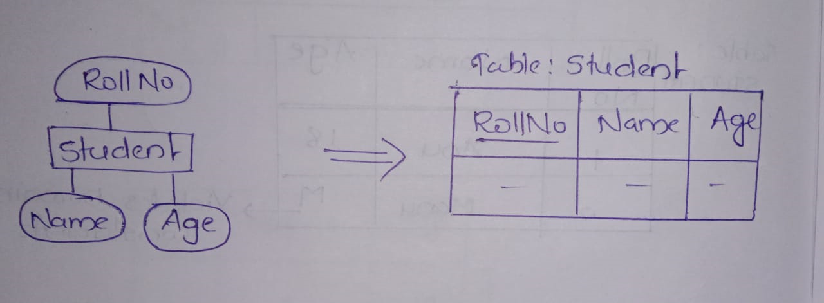
ER MODEL TO RELATIONAL MODEL
1.Create a table for each entity
2.Entity’s attribute should become fields of tables with respect to data types
3.Declare primary key

Slide 12
Relational Algebra
It is a procedural query language
It consist of a set of operation that take one or two relation as input and produce a new relation as their result
It consist of two types of operation
1.Unary operation:They operate on one relation
Eg:Select,Project
2.Binary operation:They operate on pairs of relationships
Eg:Cartesian product

Slide 13
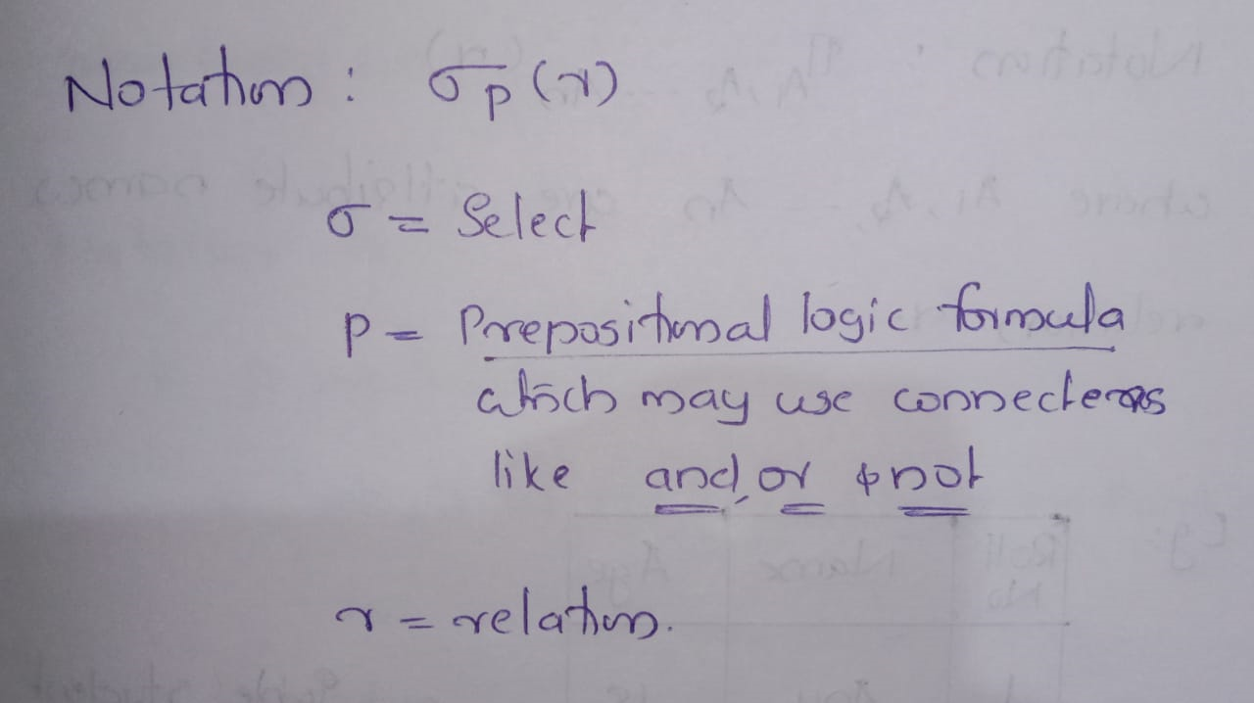
Select operation
The select operation select tuples that satisfy a given predicate

Slide 14
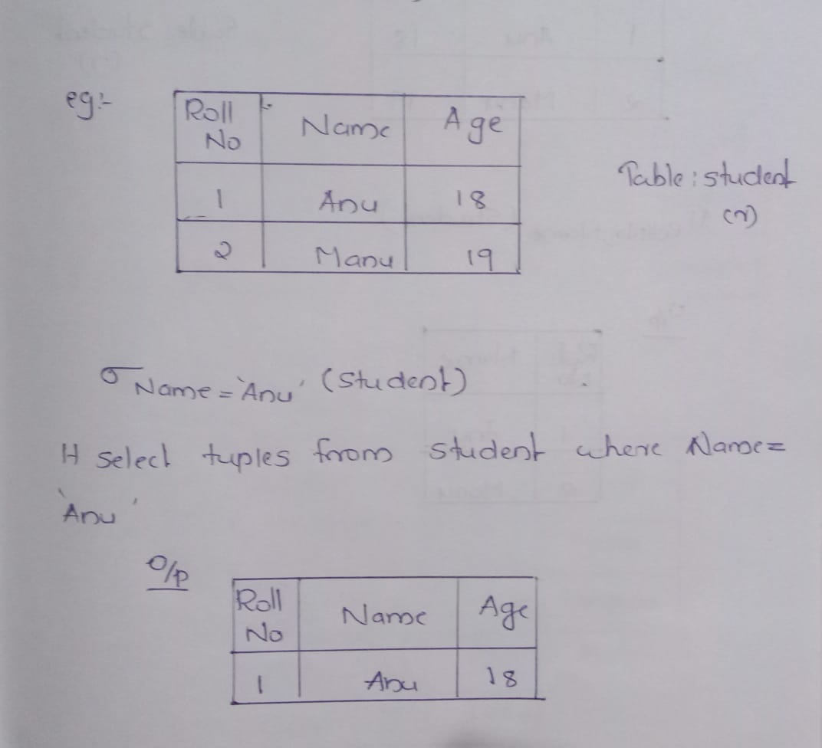

Slide 15
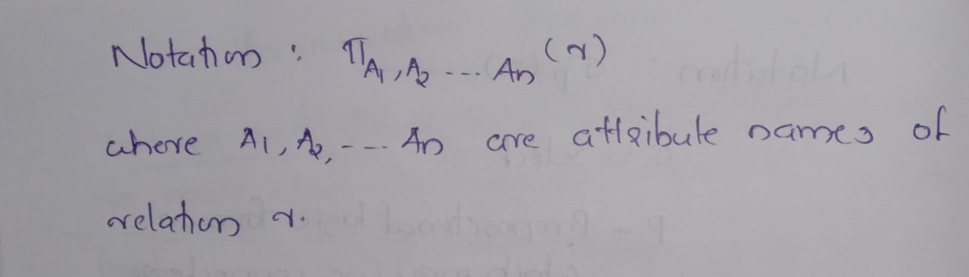
Project operation
It projects attributes(columns) that satisfy a given predicate

Slide 16
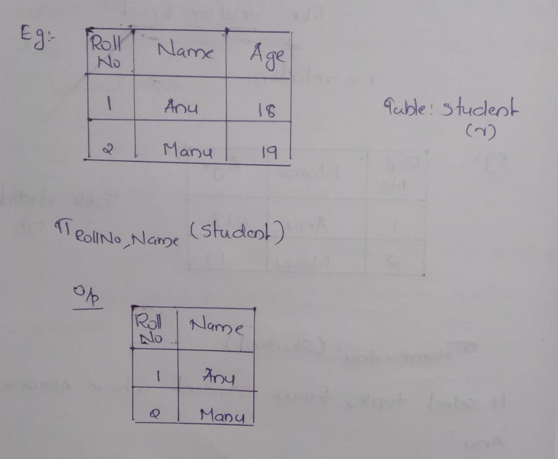

Slide 17
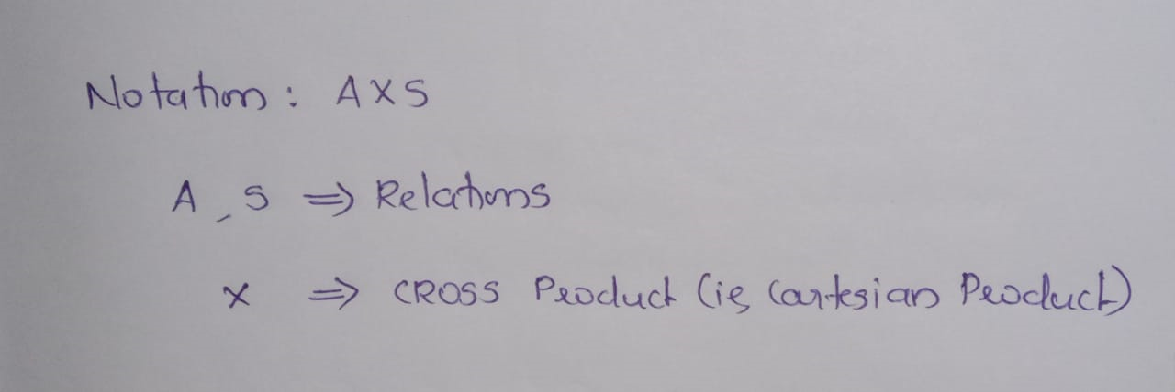
Cartesian product
It combines information of two different relations into one relation

Slide 18
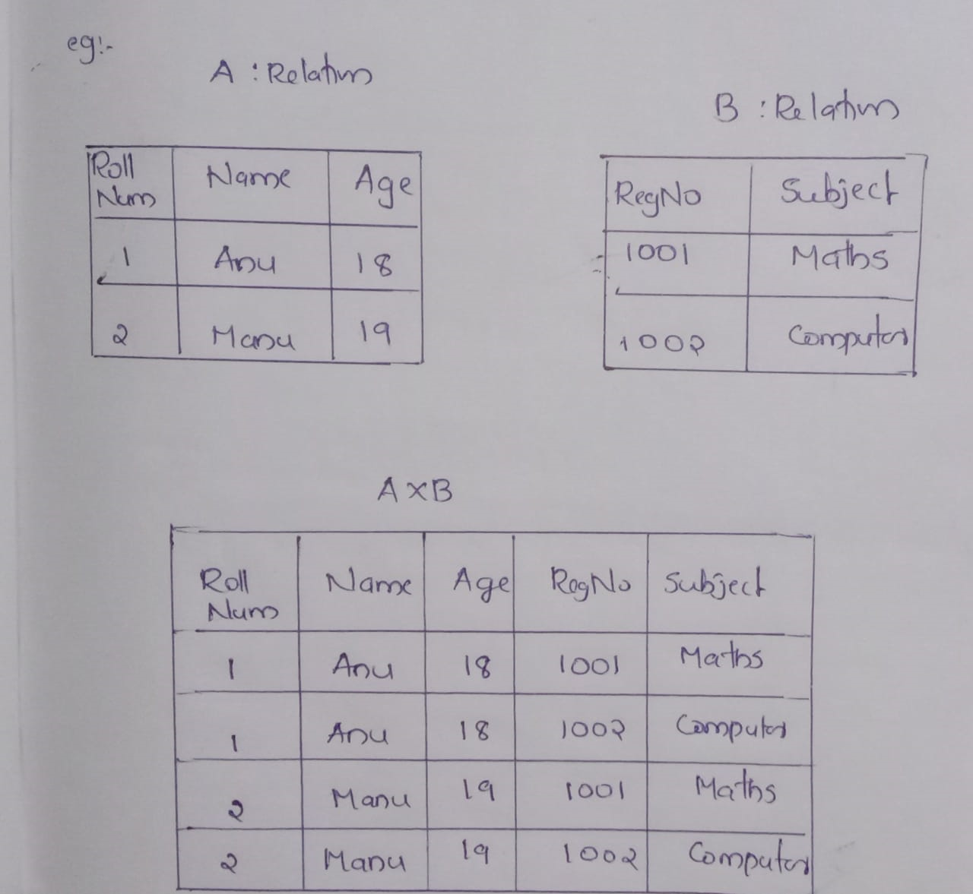

Slide 19
THANK YOU

Slide 20
dbms
Module 2 part 2

Slide 21
index
Structured Query Language (SQL)
DDL
CREATE
DROP
ALTER
DML
INSERT
DELETE
UPDATE
JOIN
EQUI-JOIN
NATURAL JOIN

Slide 22
sql
The SQL(Structured Query Language) is a standard language for storing and managing data in a RDBMS.
It enables a user to create,read,update and delete relational databases and tables
SQL is not case sensitive. Generally, keywords of sql are written in upper case
SQL comprises DDL and DML. Using DDL, one can design and modify database schema whereas DML used to store and retrieve data from database

Slide 23
ddl
CREATE
DROP
ALTER

Slide 24
CREATE
Creates new databases,tables and views from RDBMS
CREATE TABLE tablename(col1 datatype,col2 datatype,….);
Eg: CREATE TABLE student(id int primary key,name varchar(20));

Slide 25
alter
Modifies database schema(ie, structure of the DB)
ALTER TABLE tablename ADD columnname datatype;
Eg: ALTER TABLE student ADD mark int

Slide 26
drop
It is used to delete whole database or just a table
DROP TABLE|DATABASE tablename|databasename;
Eg: DROP TABLE student;

Slide 27
DML
INSERT
UPDATE
DELETE

Slide 28
INSERT
It is used to insert data into table
INSERT INTO tablename(col1,col2,…) VALUES(value1,value2,..);
Eg: INSERT INTO student VALUES(1,ashi);

Slide 29
update
It is used to update existing data within a table
UPDATE table_name SET col1=val1,col2=val2,.. WHERE condition;
Eg:UPDATE student SET name='anu' WHERE id=1

Slide 30
delete
It is used to delete records from a table
DELETE FROM tablename WHERE condition;
Eg:DELETE FROM student WHERE id=1;

Slide 31
join
It is used to combine two tables based on a specified common field between them
EQUI-JOIN
NATURAL JOIN

Slide 32
Equi-join
It performs a JOIN against equality or matching column(s) values of the associated tables
An equal sign(=) is used as comparison operator in the where clause to refer equality
SELECT columnlist FROM table1,table2 WHERE table1.columnname = table2.columnname;
You may also perform EQUI-JOIN by using JOIN keyword followed by ON keyword
SELECT * FROM table1 JOIN table2[ON (join_condition)];

Slide 33
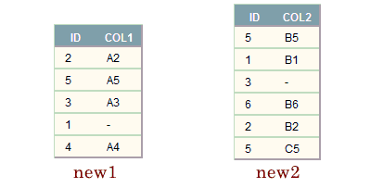
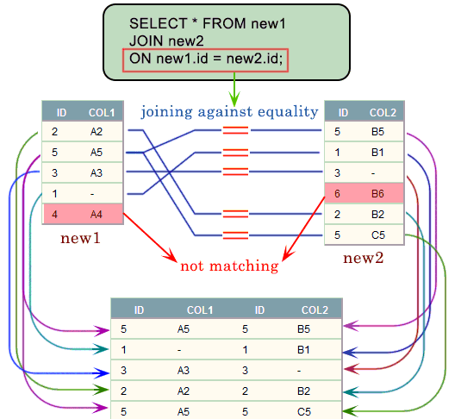

Slide 34
Natural join
It is a type of EQUI-JOIN and is structured in such a way that, columns with the same name of associated tables will appear once only
SELECT * FROM table1 NATURAL JOIN table2;

Slide 35
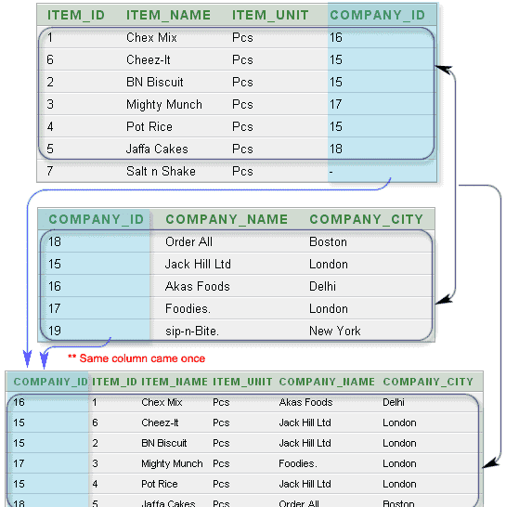

Slide 36
THANK YOU

